Slide 1
Cost of Living | United States
Joshua Hiatt

Slide 2
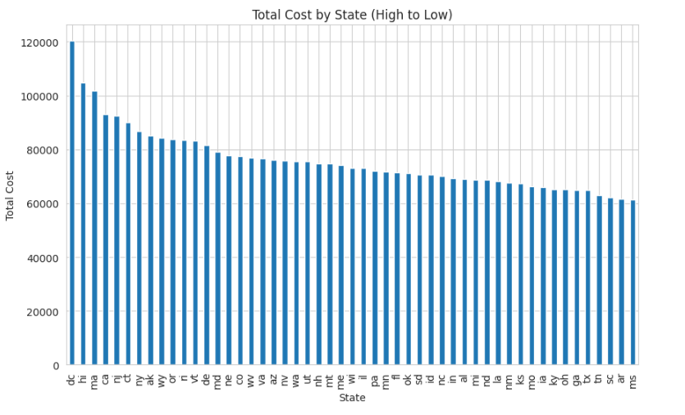
What’s the cheapest and most expensive State?

Slide 3
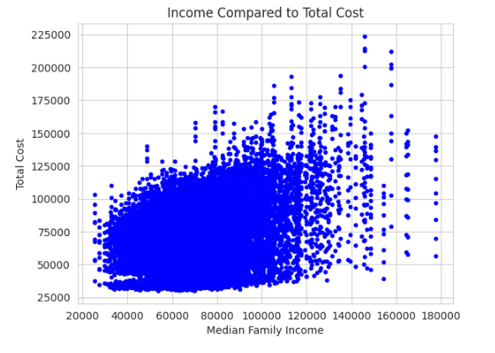
How does income relate to total cost?

Slide 4
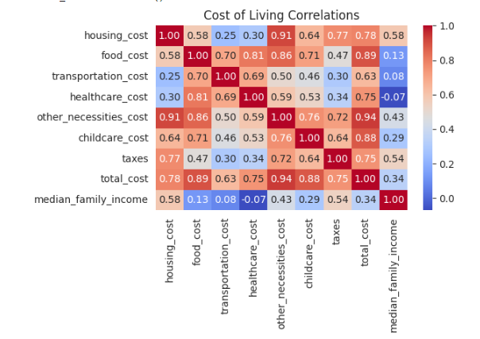
What’s Driving the cost
Housing – 0.78
Food – 0.89
Transportation – 0.63
Taxes – 0.75
Healthcare – 0.75
Childcare – 0.88
Other Necessities – 0.94

Slide 5
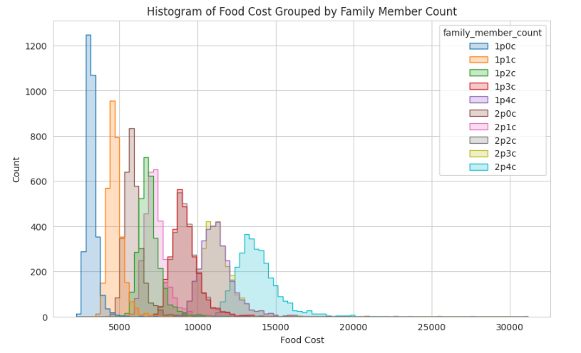
Family Size and Food Cost

Slide 6
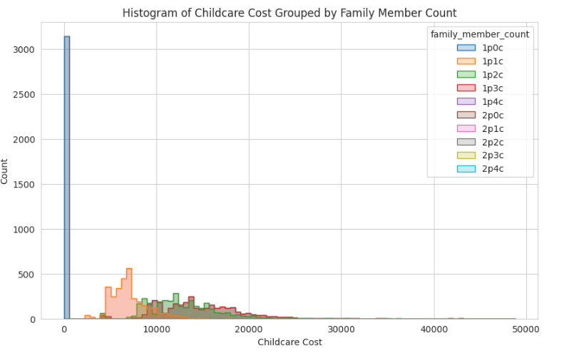
Family Size and Childcare Cost

Slide 7
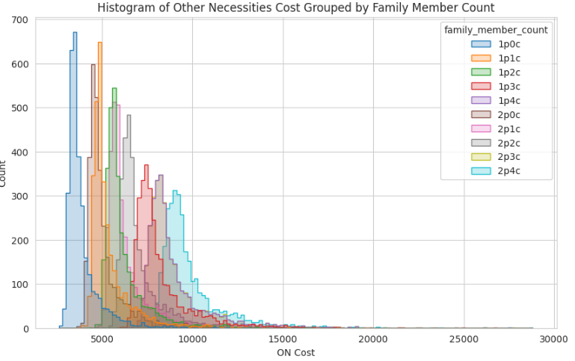
Family Size and Other Necessities Cost

Slide 8
2 People 0 children are second in cost to 2 parent 4 children in two major categories. What is Driving This Similiarity?
Are Two People 0 Child Families Spending More on Food Because They Are Dining Out?
Are Two People 0 Child Spending More On Educational Related Costs That Would Drive Up Other Necessities?
How is Other Necessities Defined?
Are Two People 0 Child Families Spending Similar ON Amounts As They Are Purchasing Higher Quality Versions to the 2P4C Households?

